Slide 1
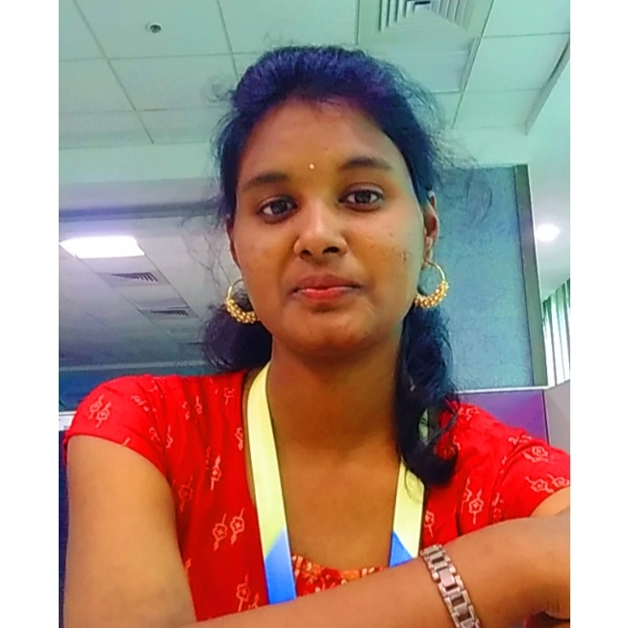



Chidurala Lasya
Analyst/Software Engineer
Bachelor of Engineering
Computer Science : 2016 - 2020
Skills
Bangalore
Java 8 /J2EE | Java Basics, OOPS, Generics, Collections, Arrays, Loops, Lambda Exp, Stream API Junit, Mockito, Servlets
Spring core | IOC & Dependency Injection, Auto wire
Spring REST | REST controllers, Implementation of GET, POST, PUT & DELETE, Bean Validation & Exception Handling, Testing Services, Controller & Repository layer
Spring Data JPA | Implement DAO layer using spring Data repositories, Transaction Management
Spring Boot Microservices | Spring Boot Starters, annotations, Messaging Service, Sync/Async comms, Swagger API specifications
Spring Cloud | Eureka, Hystrix, Zuul & Config Server
React | Components, Hooks, Event handling, Redux, Reducers.
Database | MongoDB No Sql Advanced
UI Tech | HTML 5 & CSS 3,JavaScript, ES6 & TypeScript Reusable templates, Optimized UI Designed
Tools | Git, Postman, Maven, IDE,PMD,Checkstyle
Add On skills | Communications, Team management. Peer learning
lasya.chidurala@capgemini.com
8919662527
A4
Software engineer with strong design and integration skills and intuitive in problem solving skills. Passion for implementing and starting a new project.
I’m willing to learn and implement new technologies to further improve my Knowledge.
Java Microservice Development knowledge using Spring boot and spring cloud framework on an intermediate level.
. Hands on experience in creating microservices with Spring boot, Spring Security, Spring Cloud API Gateway, Eureka server.
Proficient React developer with working knowledge on ReactJS(Hooks, redux).
On Demand Car Wash System
Completed end to end case study of On Demand car Wash System Application along with Swagger and Data validation for UI for Customer Login. UI and React Bootstrap used for user interface.
HTML CSS JAVASCRIPT for web developers
Hands-on experience on HTML CSS and Designed a website for Mario gaming.
Check out my work on GitHub & Video Profile

